Slide 2
U.S.-China IP Relations: Past, Present & Future
Duncan F. Willson
IP Counselor, US Embassy, Beijing
November 29, 2022

Slide 3
U.S.-China IP Relations - Overview
Early Developments
Normalization & Post-WTO
Current & Future Cooperation

Slide 4
U.S. – China IP Relations: Early Developments

Slide 5
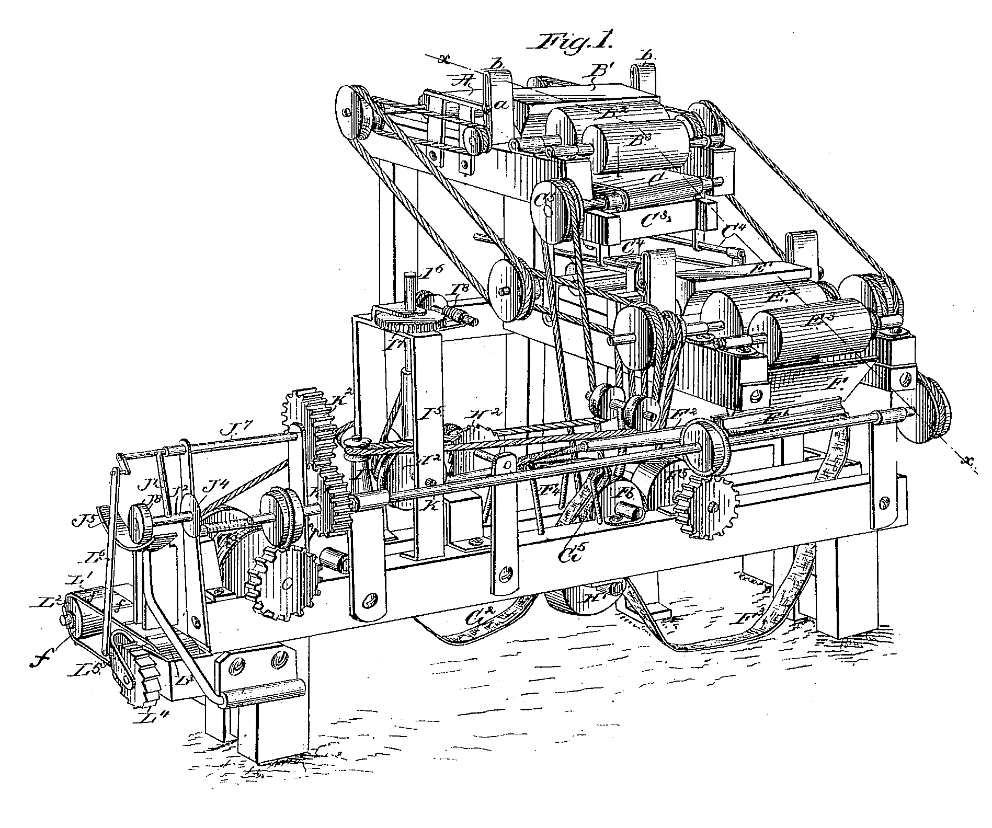
U.S.-China IP Relations – Early Developments
First Patent Case in China – July 1, 1897: R.W. Mustard and C.C. Bennett v. G.H. Wright
Issue: Contractual restrictions on use of the patented "Bonsack Cigarette Machine" after patent expired
Court? U.S. Consulate, with Consul-General serving as judge
Applicable Law? U.S. Law applied to acts occurring in China

Slide 6
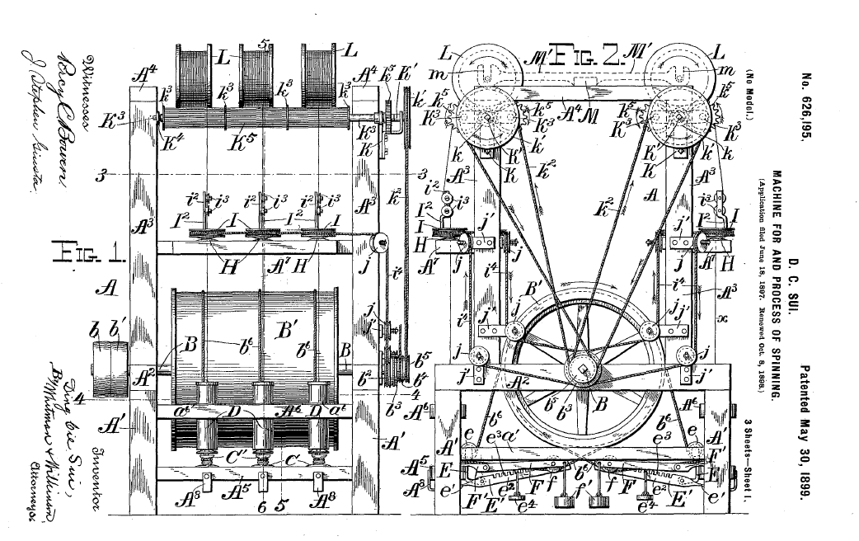
U.S.-China IP Relations – Early Developments

Slide 7
U.S.-China IP Relations – Early Developments
1903 Treaty between the U.S. and China:
“The United States of America and His Majesty the Emperor of China, being animated by an earnest desire to extend further the commercial relations between them...”
Art. 9 – Trademark Protection: U.S. trademarks registered “by the proper authorities” “at such offices as the Chinese Government will establish for such purpose, on payment of a reasonable fee, after due investigation by the Chinese authorities” would be afforded protection in China
Art. 10 – Patent Protection: “The Government of China now agrees that it will establish a Patent Office”, after which laws with regards to inventions shall be passed and "after the payment of the prescribed fees," this patent office will "issue certificates of protection“
Art. 11 – Copyright Protection: “The Government of China…now agrees to give full protection, in the same way and manner and subject to the same conditions upon which it agrees to protect trade-marks, to all citizens of the United States who are authors, designers or proprietors of any book, map, print or engraving especially prepared for the use and education of the Chinese people …“

Slide 8
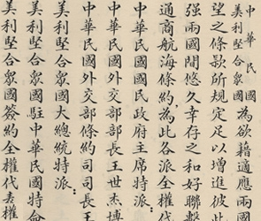
Post-Qing Cooperation; Post-Revolution Isolation
1946 – FCN Treaty signed between Republic of China (ROC) and U.S.
Nationals of either Party shall enjoy “all rights and privileges of whatever nature in copyrights, patents, trademarks, trade names, and other literary, artistic and industrial property, upon compliance with the applicable laws and regulations”…”upon terms no less favorable than are or may hereafter be accorded to” its own nationals.
1949 – U.S. and China severed economic relations

Slide 9
U.S. – China IP Relations: Normalization & Post-WTO

Slide 10
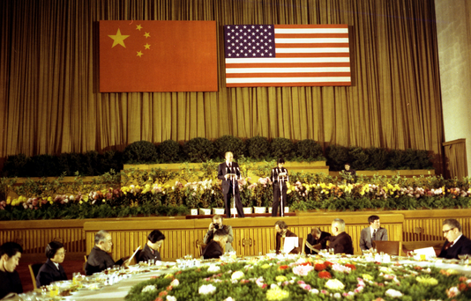
U.S.-China IP Relations - Normalization
July 1979 – Bilateral Trade Agreement -
Art. 6 – “Both Contracting Parties in their trade relations recognize the importance of effective protection of patents, trademarks and copyrights….”
July 1979 - Delegation of PRC officials and scientists from the PRC Science and Technology Association visit US to learn about innovation and Patent Policy

Slide 11
U.S.-China IP Relations – Post-WTO
2007 WTO Case
Final Decision: Mixed
US failed to demonstrate that China's criminal thresholds for infringement were inconsistent with Art. 61 of the TRIPS Agreement
But: Art. 4 of the Copyright Law found to be inconsistent with China's obligations under TRIPS and the Berne Convention
Customs measures allowing for removal of infringing trademark prior to sale at public auction found to be impermissible.

Slide 12
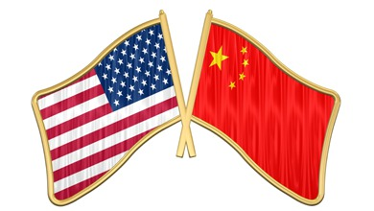
U.S.-China IP Relations – Post-WTO
MOUs Signed
USPTO signs MOUs with SIPO, NCA, and SAIC in 2008
U.S.-China Innovation Dialogue
Launched in 2010
Cooperative Framework Agreement (CFA)
Signed by USPTO, USTR, and MofCOM in Chengdu, November 21, 2011
Jiangsu Memorandum of Understanding (MOU)
Signed on July 21, 2011
First-of-its-kind, MOU between the USPTO and a sub-national government

Slide 13
U.S.-China IP Relations – Phase One
U.S.-China Economic and Trade Agreement Signed
January 15, 2020 ; Effective February 14, 2020
8 Chapters
IP
Tech Transfer
Trade in Food and Ag Products
Financial Services
Macro/Exchange Rate
Expanding Trade
Evaluation/Dispute Resolution

Slide 14
U.S.-China IP Relations – Phase One
IP Chapter
Trade Secrets / CBI
Pharma-related IP
Patents
E-Commerce Piracy/Counterfeiting
Geographical Indications
Manufacture/Export of Pirated/Counterfeit Goods
Bad Faith Trademarks
Judicial Enforcement
Bilateral Cooperation
Technical Calls
Written Exchanges

Slide 15
U.S. – China IP Relations: Current & Future Cooperation

Slide 16
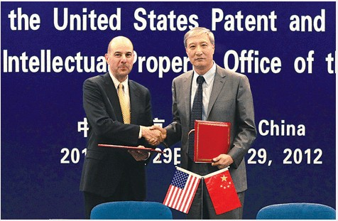
U.S.-China IP Relations – Collaboration
China as an IP Stakeholder - David Kappos, then Under Secretary of Commerce for Intellectual Property and Director of the USPTO

Slide 17
Patent Filings: U.S. in P.R.C. / P.R.C. in U.S.

Slide 18
Trademark Filings: U.S. in P.R.C. / P.R.C. in U.S.

Slide 19
U.S.-China IP Relations – Engagement
Central-level
CNIPA
Work Plan
Joint Seminars
Meetings
SPC, SPP, SAMR, NCAC, GACC
CTA, QBPC

Slide 20
U.S.-China IP Relations – Engagement
Virtual Seminars – Public / Non-Public
Patents
Patent Linkage
Patent Classifications
Patent Quality Management
Industrial Designs
Trademark Protection

Slide 21
U.S.-China IP Relations – Engagement
Local-level
Shanghai / Guangzhou IP Attache
IPOs
Courts
Customs
Technology Platforms
Phase One Engagement
Technical Calls
Written Exchanges

Slide 22
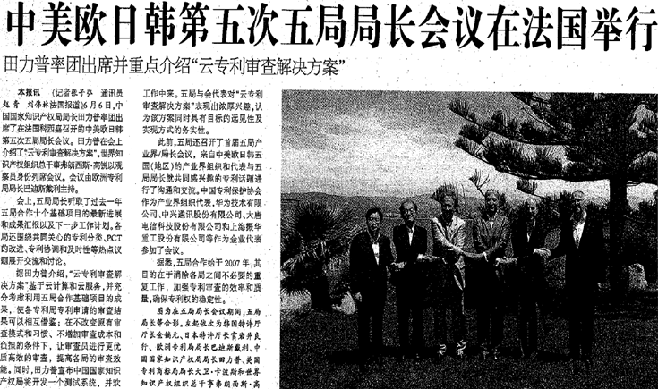
U.S.-China IP Relations – Collaboration
International Collaboration
IP5, TM5, ID5

Slide 23
U.S.-China IP Relations – Engagement
Active Research & Reporting
Non-Market Factors driving filing trends in China & Abroad
Work with Partners
Like-minded IP Offices and Officers

Slide 24
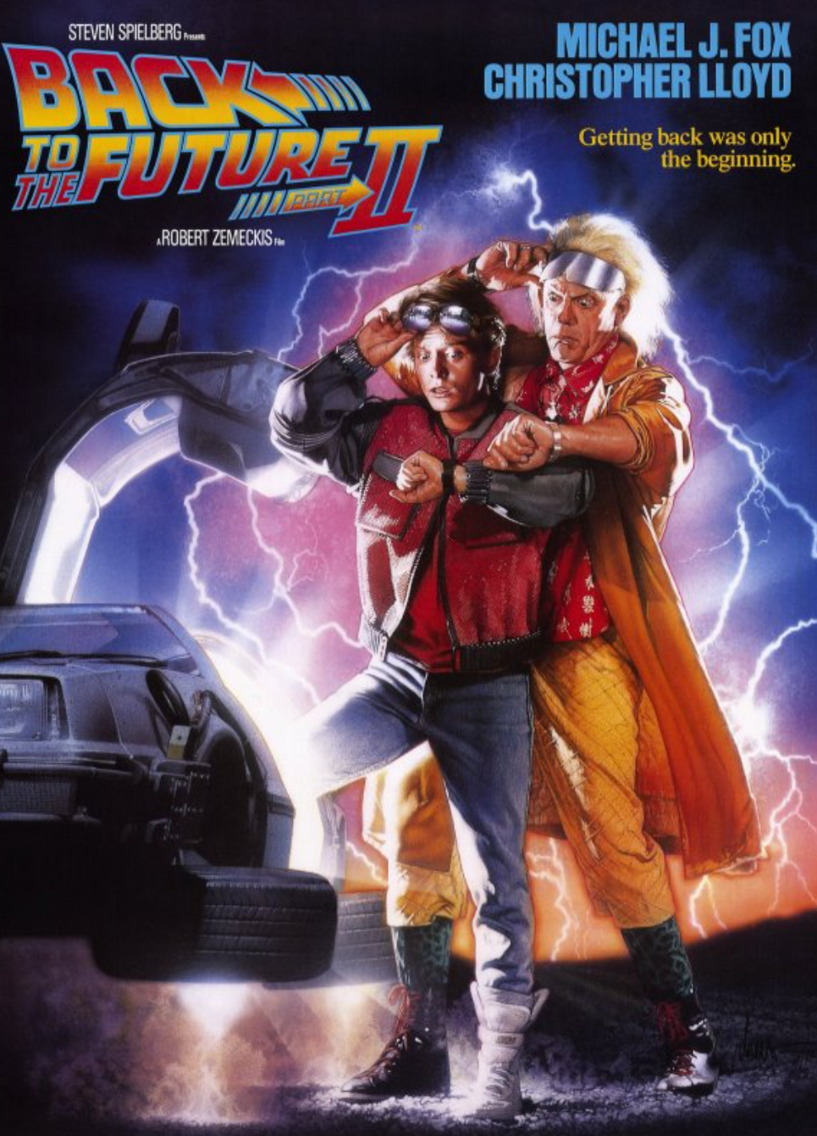
U.S.-China IP Relations – Future?
Hard to Predict
Continued Engagement Needed
IP System / Technologies Always Evolving
© 1989 Universal City Studios, Inc

Slide 25
Questions? Thank You!
Duncan Willson
Intellectual Property Counselor
U.S. Embassy, Beijing
Phone: +86 10 8531 4812
Email: Duncan.willson@trade.gov (2 L’s)

